Slide 1

Introduction to Patient and Public Involvement (PPI) at Cambridge Clinical Research Facility
Caroline McMahon
NIHR Cambridge CRF, PPI Lead
Deepa Mistry
NIHR Cambridge CRF, Public Contributor
1

Slide 2
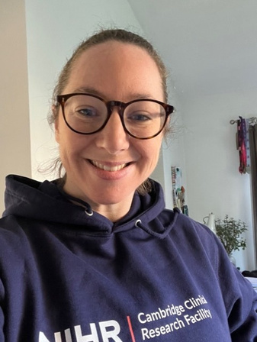
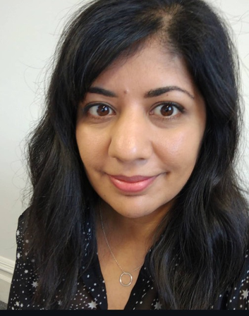
Hello and welcome
This is an introduction Patient and Public Involvement (PPI) and Research Inclusion at NIHR Cambridge Clinical Research Facility (CRF).
My name is Caroline, and I am the PPI Lead here at the CRF (left). Together with Deepa, CRF Public Contributor (right), we hope you find this introduction informative.
If you have any questions, would like to know more or to get involved, please get in touch.
I am based on CCRC L3 and my email is: caroline.mcmahon3@nhs.net
We also have, 6 unit based PPI champions supporting the work of PPI and Inclusion across the CRF.
Working alongside us; the CRF, CIW, CCRC and HLRI CRF- has a dedicated PPI Research Champion
2

Slide 3
This presentation will help you understand PPI and the CRF, you'll learn:
Know what PPI is and why it is important.
Know the difference between patient and public involvement, engagement and participation
Benefits to PPI
Learn good practices of PPI
Barriers to PPI
Equality, Diversity and Inclusion (EDI) in Research
Examples of PPI projects here at NIHR Cambridge CRF
3

Slide 4
What is Patient and Public Involvement (PPI)?
Public involvement in research is an active partnership between patients, carers and members of the public. It helps researchers shape and influence research.
'Public' includes patients, potential patients, carers and people who use health and social care services. It also covers people from specific communities and those with lived experience of health conditions.
4

Slide 5
Patient and Public Involvement, Engagement
and Participation explained
Involvement: where members of the public are actively involved in research projects and in research organisations (Better ideas, experiences- better questions)
Participation: where people take part in a research study- providing the data to answer the research question
Engagement: where information and knowledge is provided and disseminated- raising research awareness and sharing our work.
To read more, click here and visit peopleinresearch.org
5

Slide 6
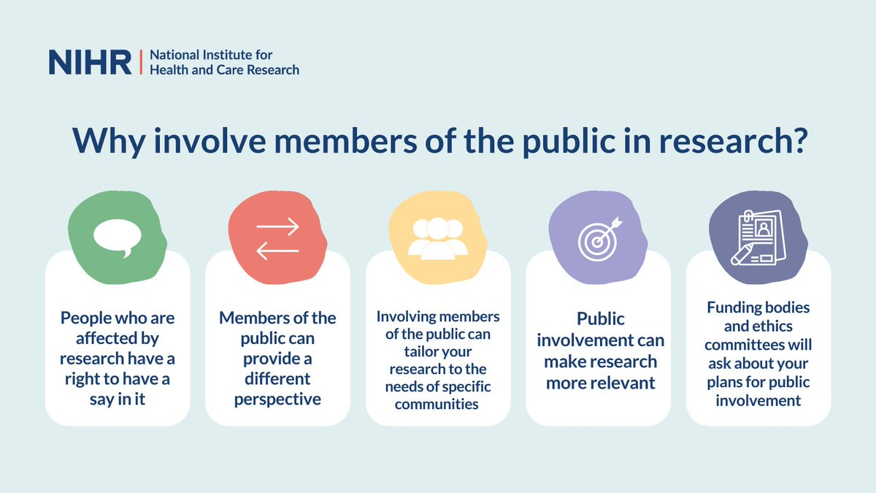
Read more about the benefits of PPI for researchers here
6

Slide 7
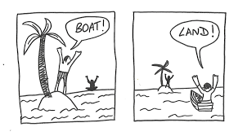
Perspective
different needs, have different perspective
7

Slide 8
UK Standards for Public Involvement
The UK Standards for Public Involvement are a description of what good public involvement looks like.
They encourage approaches and behaviours that are the hallmark of good public involvement such as: flexibility, sharing and learning, and mutual respect.
The Standards are for everyone doing health or social care research and provide guidance and reassurance for practitioners working towards achieving their own best practice.
Communications | Use plain language for well-timed and relevant communications, as part of involvement plans and activities
Governance | Involve the public in research management, regulation, leadership and decision making
Impact | Seek improvement by identifying and sharing the difference that public involvement makes to research
Working together | Work together in a way that values all contributions, and that builds and sustains mutually respectful and productive relationships.
Support and Learning | Offer and promote support and learning opportunities that build confidence and skills for public involvement in research
Inclusive Opportunities | Offer public involvement opportunities that are accessible and that reach people and groups according to research needs.
Click here to read the UK PPI standards for Public Involvement
8

Slide 9

What are the ethical considerations?
When involving patients and the public in research, key ethical considerations include:
ensuring informed consent,
respecting their autonomy,
protecting confidentiality,
managing potential conflicts of interest,
ensuring equitable representation,
guaranteeing that their involvement is meaningful and contributes directly to the research design and execution, not just used for tokenistic purposes
The Research Ethics Service will ask about the plans for public involvement in your research if you apply for ethical approval, and it will be part of their assessment process. They expect the involvement of the public in research, as it can help ensure that research planned is ethical, relevant and acceptable from a public perspective.
Find out more about the impact of public involvement on the ethical aspects of research. (.PDF)
9

Slide 10

Be Part of Research
Watch this short video by NIHR
10

Slide 11
Our Commitment and Governance Reporting
CUH
Trust Board
In our commitment to Patient and Public Involvement, we produced a joint NIHR Cambridge BRC and CRF PPIE strategy
This strategy details; what we want to achieve in our short, medium and long term objectives, who the CRF PPI and Inclusion Lead reports to (governance structure, right), who we are working with and how we will measure our success in delivering our objectives.
Every year we submit an annual report to NIHR, this is where we detail our PPI and Inclusion activity.
BRC-Biomedical Research Centre
CUH- Cambridge University Hospitals
CUH
Research Board
CRF
Scientific
Advisory
Board
(SAB)
CRF
Management Committee
Meeting
CRF PPI
and
Inclusion
Champions
CRF PPI
and
Inclusion Lead
11

Slide 12
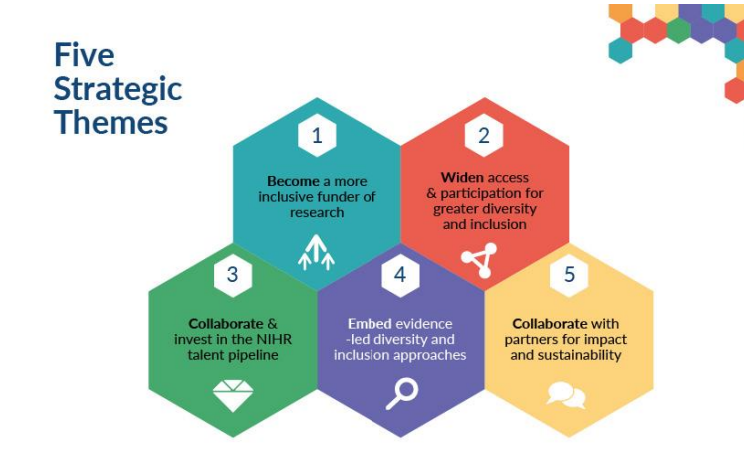
Equality, Diversity and Inclusion (EDI) in Research
One of the NIHR’s key priorities is being committed to embedding equality, diversity, and inclusion (EDI) across NIHR's research, systems and culture. Helping to foster an inclusive environment and engage the talents and energy of diverse people in all areas of our work. Read the full EDI strategy
12

Slide 13
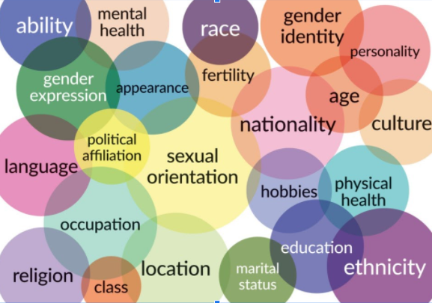
Our commitment to Equality, Diversity and Inclusion (EDI)
We have a joint EDI strategy with NIHR Cambridge BRC, our 5 strategic themes are:
Our participants
Our workforce
Our leadership
Training our workforce
EDI in PPI
We are learning about the people who already take part in research here at Cambridge CRF,
Working with our researchers to improve the inclusion of recruitment to research studies
Going out meeting members of the local and regional communities, to raise research awareness.
We ask all our CRF colleagues to undertake NIHR INCLUDE training, to understand why its important to include those from underserved communities in research.
Other EDI Training and Resources, include:
Local and national EDI training: CUH DOT, UKCRF Network and NIHR Learn
Join CUH staff network groups- See connect
“No decision about me, without me.”
13

Slide 14
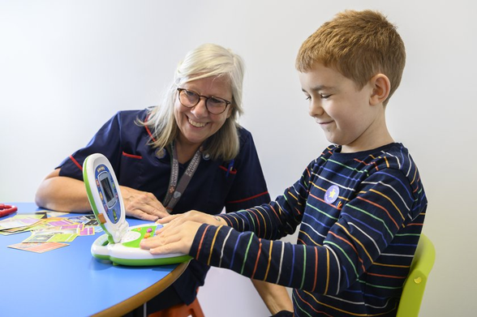
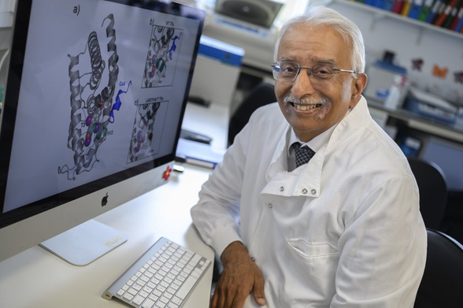

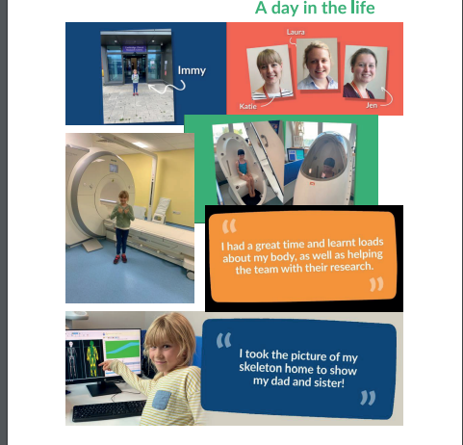
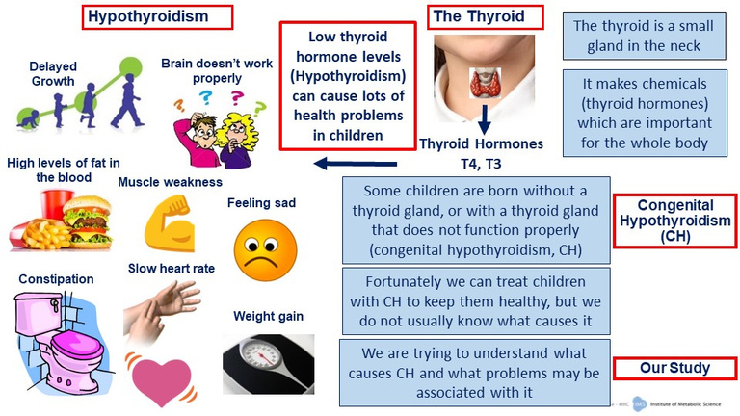
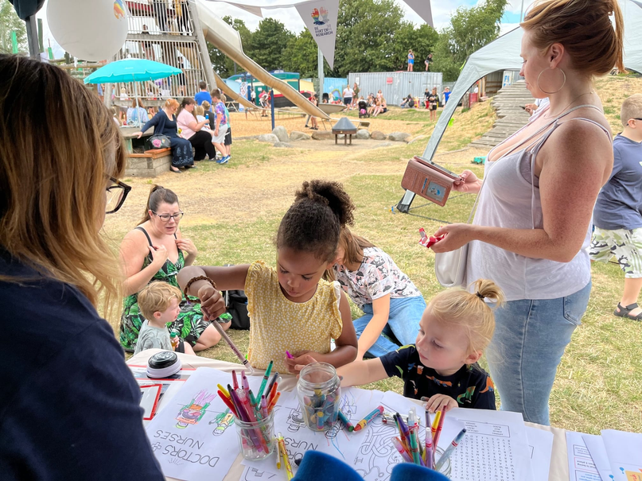
What does PPIE on the CRF look like?
We share our participant stories, hear participant feedback, celebrate the successes of our researchers and listen to the voices of others to improve health research. We also go out to different communities to raise research awareness.
14

Slide 15
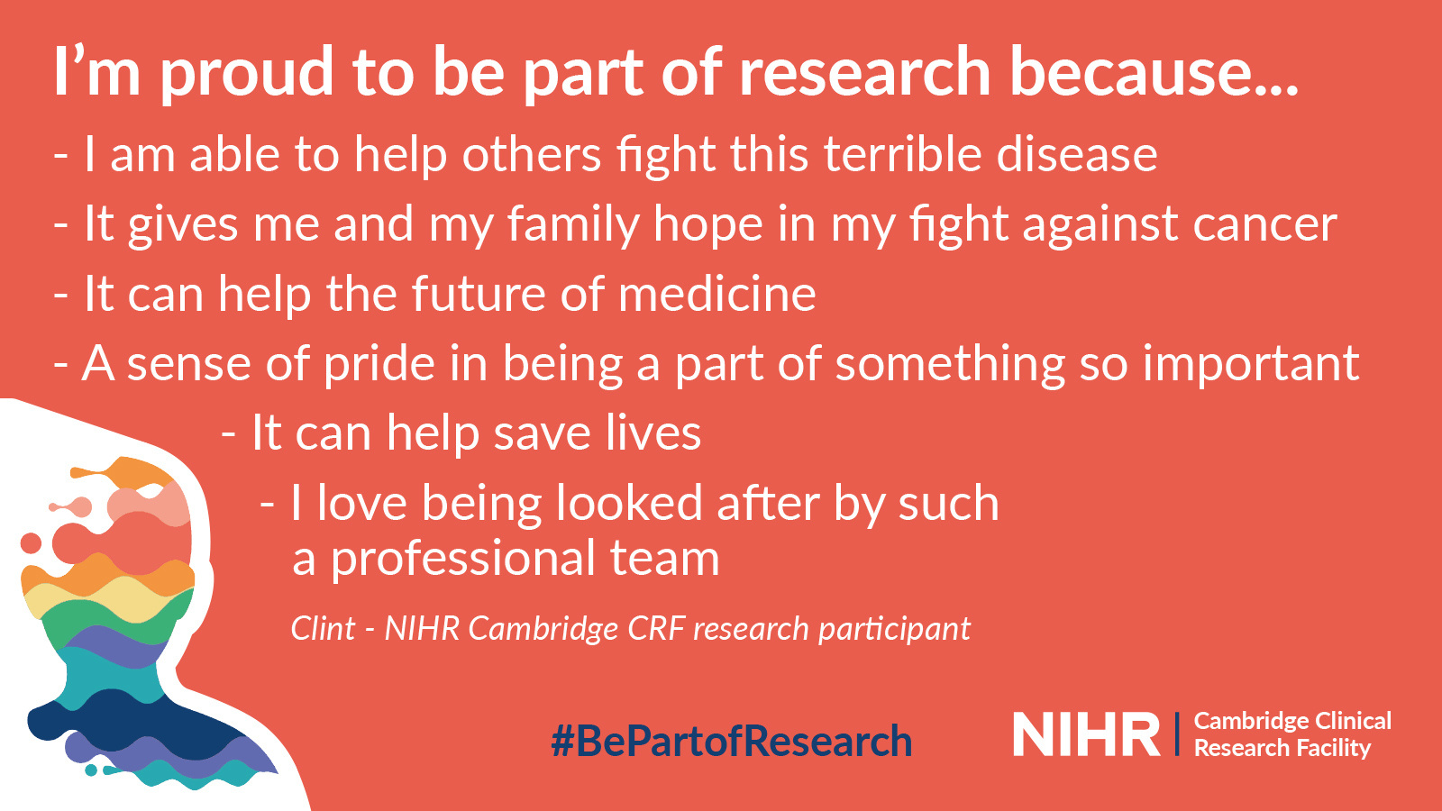
15

Slide 16

Conclusion
Patient and Public Involvement and research inclusion is for everyone.
Here at the CRF we are inventive and always willing to help raise research awareness.
We're at the delivery end of research where we are uniquely placed to improve and influence research outcomes.
We work collaboratively with the wider CRF team
We couldn't do this without you!
If you are asked about how to find out how to take part in research, send them to: https://www.peopleinresearch.org/
16

Slide 17
Further reading
NIHR | Best research for best health the next chapter
NIHR Patient and public pages
PPIE NIHR Definitions
UK PPI Standards
NIHR INCLUDE roadmap
INCLUDE training
UKCRF Network
NIHR equality, diversity and inclusion strategy
Be Part of Research
Merlin document- Equality, diversity and inclusion in employment- access for CUH staff only.
17

